Slide 1
Read Range Estimation System

Slide 2
OUTLINE
RFID OVERVIEW
DESCRIPTION
OPERATING PRINCIPLE
TYPES
USES
RFID READ RANGE ESTIMATION
FRIIS EQUATION
RFID FRIIS EQUATION DERIVATION
RELATED WORKS
SYSTEM DEVELOPMENT
SYSTEM PERFORMANCE

Slide 3
Rfid Overview
Definition of RFID :
Radio Frequency Identification (RFID) is a contactless automatic identification technology that uses electromagnetic fields to automatically identify and track tags attached to objects.
An RFID system consists of a tiny radio transponder, a radio receiver and transmitter.

Slide 4
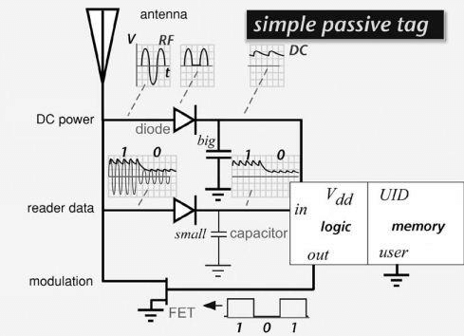
Operating Principle
An antenna structure interacts with impinging electromagnetic ﬁelds, producing a high-frequency (RF) voltage. The voltage is rectiﬁed by a diode and the resulting signal is smoothed using a storage capacitor to create a more-or-less constant voltage that is then used to power the tag’s logic circuitry and memory access. To transmit information back to the reader, the tag changes the electrical characteristics of the antenna structure so as to modify the signal reﬂected from it. Here we have shown a ﬁeld-effect transistor (FET) used as a switch; when the FET is turned on, the antenna is grounded, allowing a large current to ﬂow, and when it is off, the antenna ﬂoats allowing very little antenna current.

Slide 5
Types of Rfid
RFID systems are crucially distinguished by the frequency of the radio waves they use, by the means used to provide power to the tag.
For Frequency: We have the
Low Frequency (LF) RFID: These RFID systems operate in the 30 KHz to 300 KHz range, and have a read range of up to 10 cm
High Frequency (HF) RFID: HF systems operate in the 3 MHz to 30 MHz range and provide reading distances of 10 cm to 1 m.
Ultra-High Frequency (UHF) RFID: These systems have a frequency range between 300 MHz and 3 GHz, offer read ranges up to 12 m
By means of providing power we have:
Active: Active RFID systems have three essential parts – a reader or interrogator, antenna, and a tag. Active RFID tags possess their own power source – an internal battery that enables them to have extremely long read ranges as well as large memory banks. Typically, active RFID tags are powered by a battery that will last between 3 - 5 years, but when the battery fails, the active tag will need to be replaced.

Slide 6
Passive RFID: passive RFID tags have no internal power source. As the name implies, passive tags wait for a signal from an RFID reader. The reader sends energy to an antenna which converts that energy into an RF wave that is sent into the read zone. Once the tag is read within the read zone, the RFID tag’s internal antenna draws in energy from the RF waves. The energy moves from the tag’s antenna to the IC and powers the chip which generates a signal back to the RF system. This is called backscatter. The backscatter, or change in the electromagnetic or RF wave, is detected by the reader (via the antenna), which interprets the information.

Slide 7
Uses
RFID tags are used in many industries. For example, an RFID tag attached to an automobile during production can be used to track its progress through the assembly line, RFID-tagged pharmaceuticals can be tracked through warehouses, and implanting RFID microchips in livestock and pets enables positive identification of animals. Tags can also be used in shops to expedite checkout, and to prevent theft by customers and employees.

Slide 8
RFID READ RANGE ESTIMATION SYSTEM
RFID Read Range is the distance from which a reader can communicate/ receive signals from a tag.
Radio Frequency Identification (RFID) Read Range Estimation System is basically a system software that calculates the distance between the RFID reader device and the tag (objects) applying the RFID FRIIS EQUATION.

Slide 9
FRIIS TRANSMISSION EQUATION
The Friis transmission equation gives the power received by an antenna from another antenna that is transmitting a known amount of power at a distance under ideal conditions. The formula was derived by Herald T. Friis at Bell Labs in 1945.
Friis transmission equation :
P_{r} = P_{t} G_{t} G_{r} λ / (4πR)²

Slide 10
RFID FRIIS EQUATION DERIVATION
R = λ/4π (√ P_{r} G_{r} G_{t} τ P / P_{th} )
Where :
P_{r} is the power at the receiving antenna
P_{t} is the power at the transmitting antenna.
R is the read range
G_{t} is the transmitting antenna gain

Slide 11
G_{r} is the receiving Antenna Gain;
Antenna Gain is a measure of power radiated in a particular direction (typically the peak direction of radiation).
A_{e} is Effective Aperture;
Effective aperture is a basic antenna concept that is a measure of the power captured by an antenna from a plane wave.
P is the polarization coefficient between the reader and the tag
Τ is the impedance mismatch coefficient
P_{th} is the threshold power - the minimum power or voltage required by the chips to operate
λ is the wavelength

Slide 12
RELATED WORKS
During the course of this project we considered related works and researches carried out and their various perspectives, limitations encountered and how they were able to improve their individual works.

Slide 13
SYSTEM DEVELOPMENT
This system estimates the distance between RFID reader and its Tag counterpart by entering the required parameters into the system.
Hence, a bottom-top approach is used while developing the software. JavaScript was used for developing the functional part of the software whereas HTML & CSS was used for the user-interface(aesthetics).
Although, there are other possible languages that could be used to develop the functional component of this app; such languages include: python, Java and C++. These languages are also high level languages but we chose JavaScript because
User
input
System flow chart
Error?
Print error
message
Y
N
Calculate distance using parameters entered
Output

Slide 14
Our ample knowledge of the syntax and characteristics
It has proven over the years to be a reliable and flexible language for all use cases
It has a huge support community
It has a cheap implementation procedure
It supports multi-platform integration
Development Process flow
Conceptualization of app design and user-interface
Design implementation and prototyping
Revision and approval of design by the supervisor
Final revision and testing
Parameters description and implementation of function with JS
Development of the user-interface using HTML&CSS
Deployment and hosting of software

Slide 15
SYSTEM PERFOMANCE
Here we will talk about the performance and how reliable our software results are.
Firstly, we conducted a performance test on our application and the results are shown on the next-slide.
These results showed the performance of our application to be 85% which is a score high above average. The results also shows that it only takes 3.1s for our application to completely load.

Slide 16
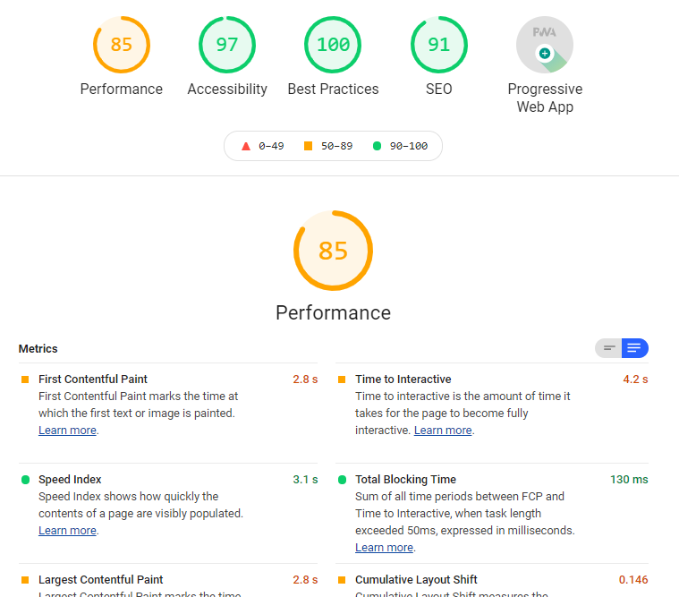
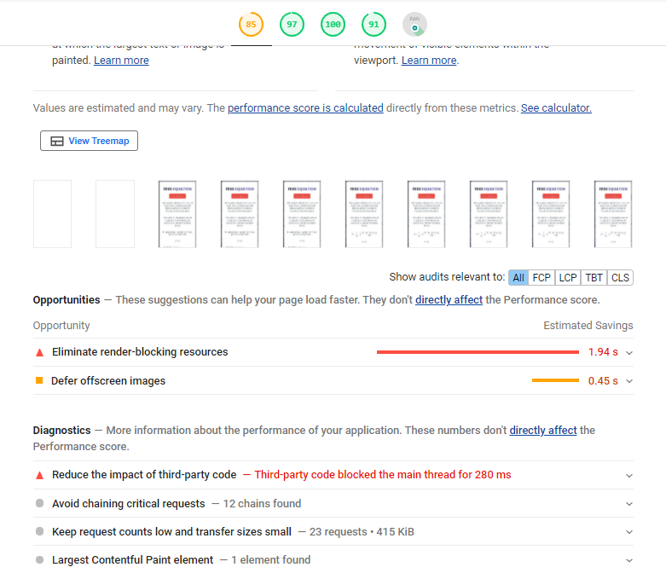
TEST RESULTS

Slide 17
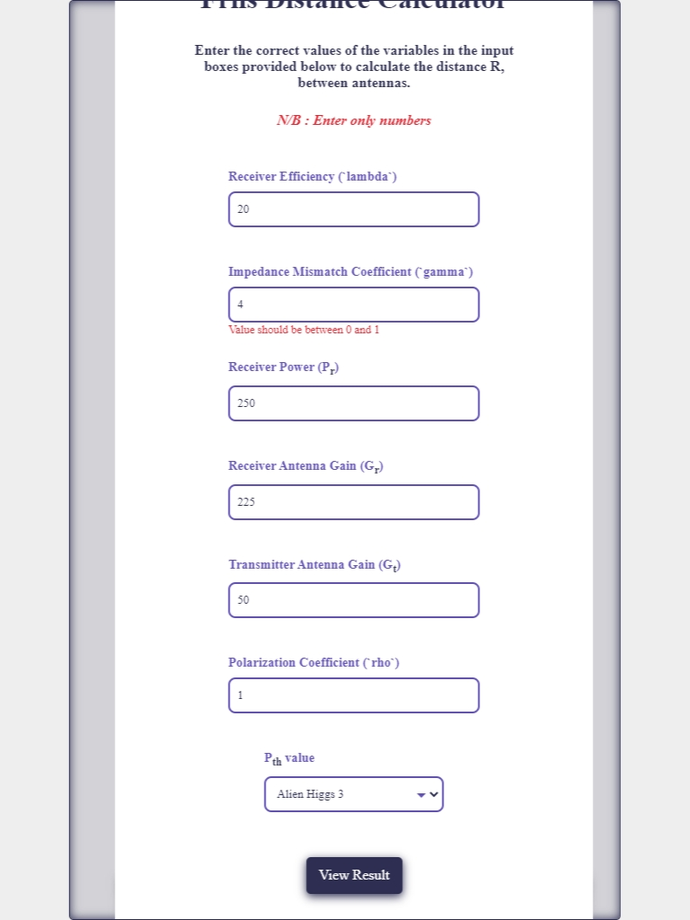
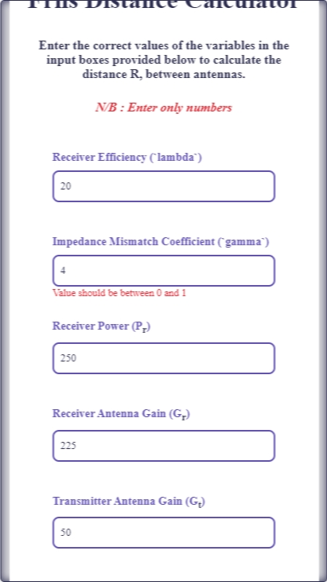
ERROR HANDLING

